Slide 1

MASS MAIL DISPATCHER
From:
Sharanya Rao
Web development Intern
To:
Exposys Data Labs, Bengaluru

Slide 2
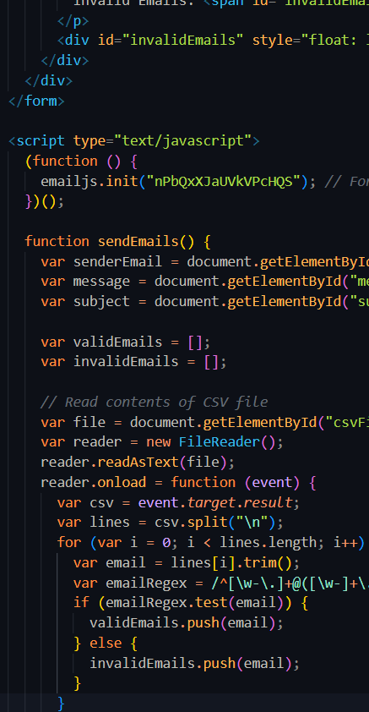
What the website is about:
The Mass-Mail Dispatcher project is a web-based application designed to simplify the process of sending mass emails to many recipients. A mass email dispatcher, email validation, and a user-friendly front-end website play a crucial role in effective email communication for businesses and organizations. This website has been developed using HTML5, CSS and JAVASCRIPT and uses EmailJS API to send the valid mails.

Slide 3
USER Instructions:
Open the index.html file in your web browser.
01
Upload a CSV file containing email addresses.
02
The website will then sort the email addresses and separate the valid and invalid emails.
03
Enter from user, email subject and body(message).
04
Click on the send Emails button to dispatch the emails.
05
For the user to send emails through the website, please follow the video instructions to connect the EmailJS API with the website.
06

Slide 4
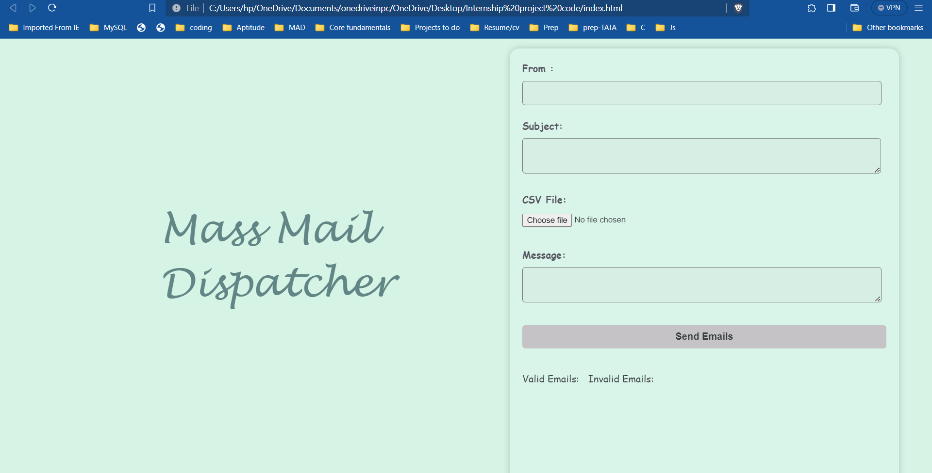
This is how the front-end of the website looks like.

Slide 5
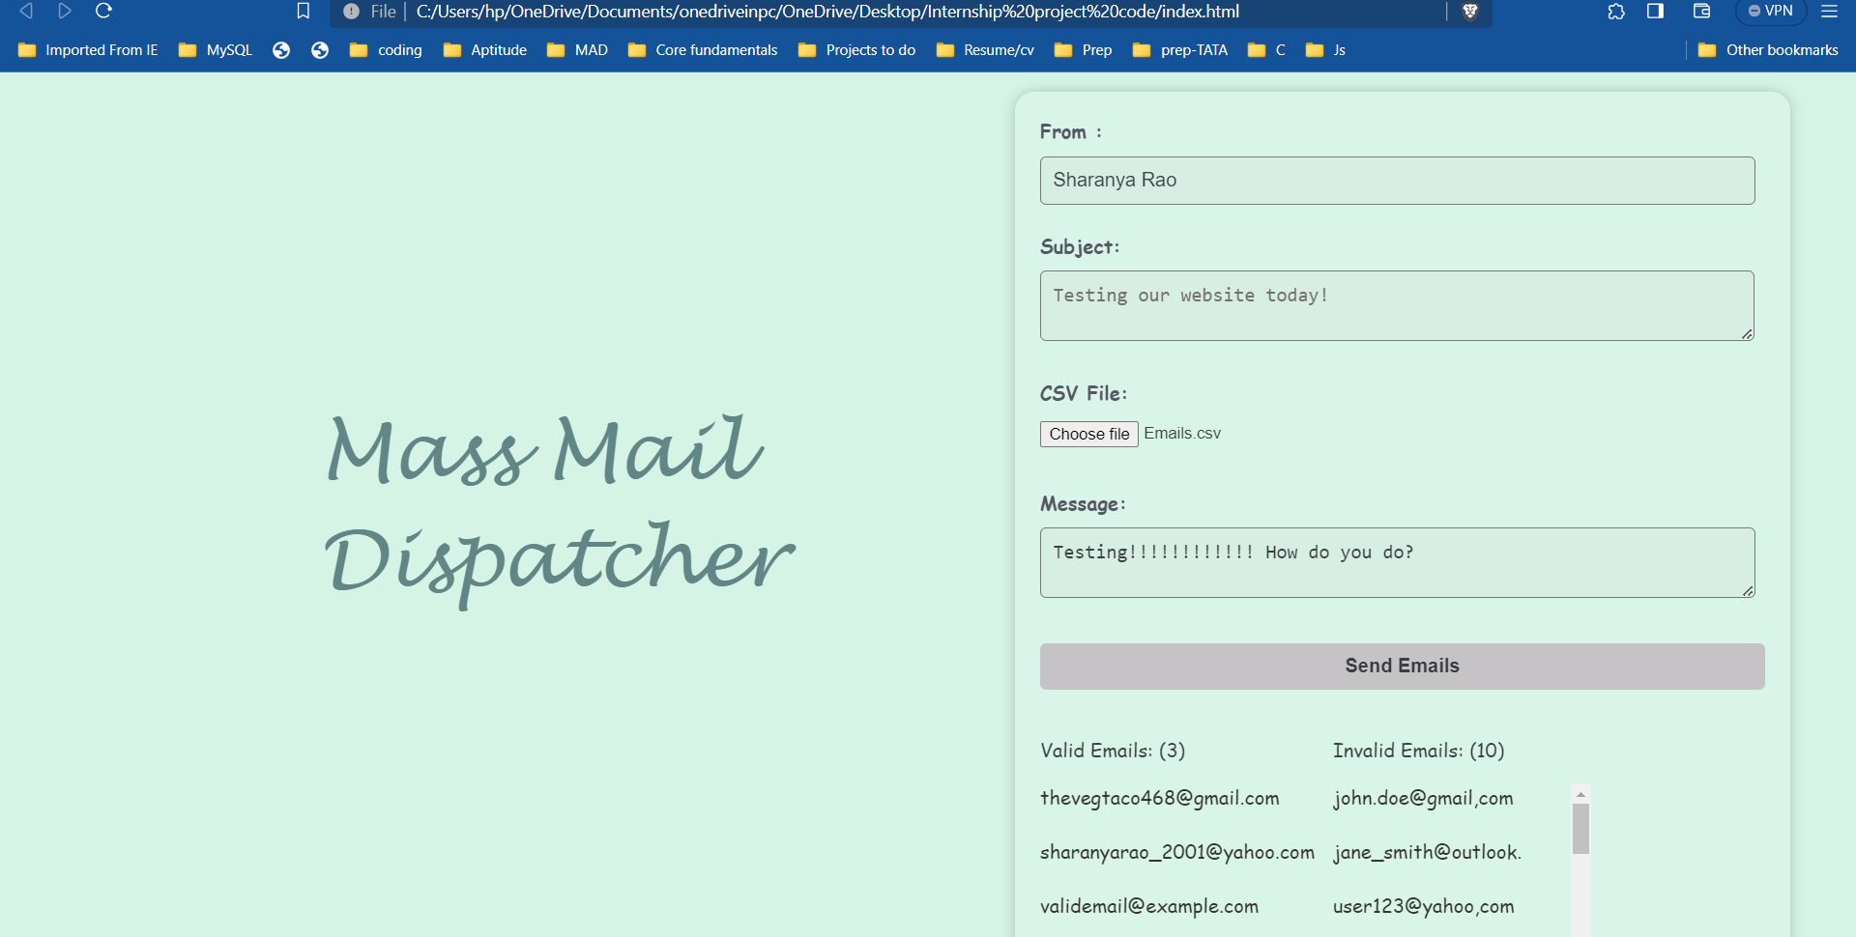
OUTPUT:
Fill the front-end website
The website separates the valid and invalid emails from the emails.csv file

Slide 6
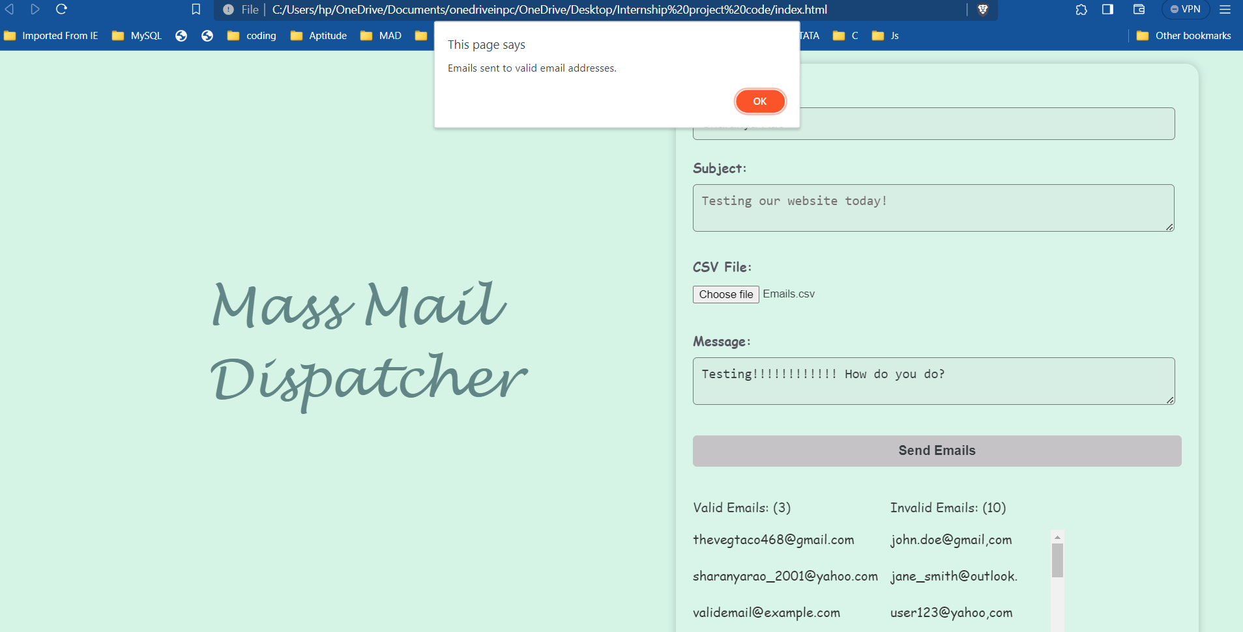
OUTPUT:
Notification sent saying the email from user sent to valid email addresses.

Slide 7
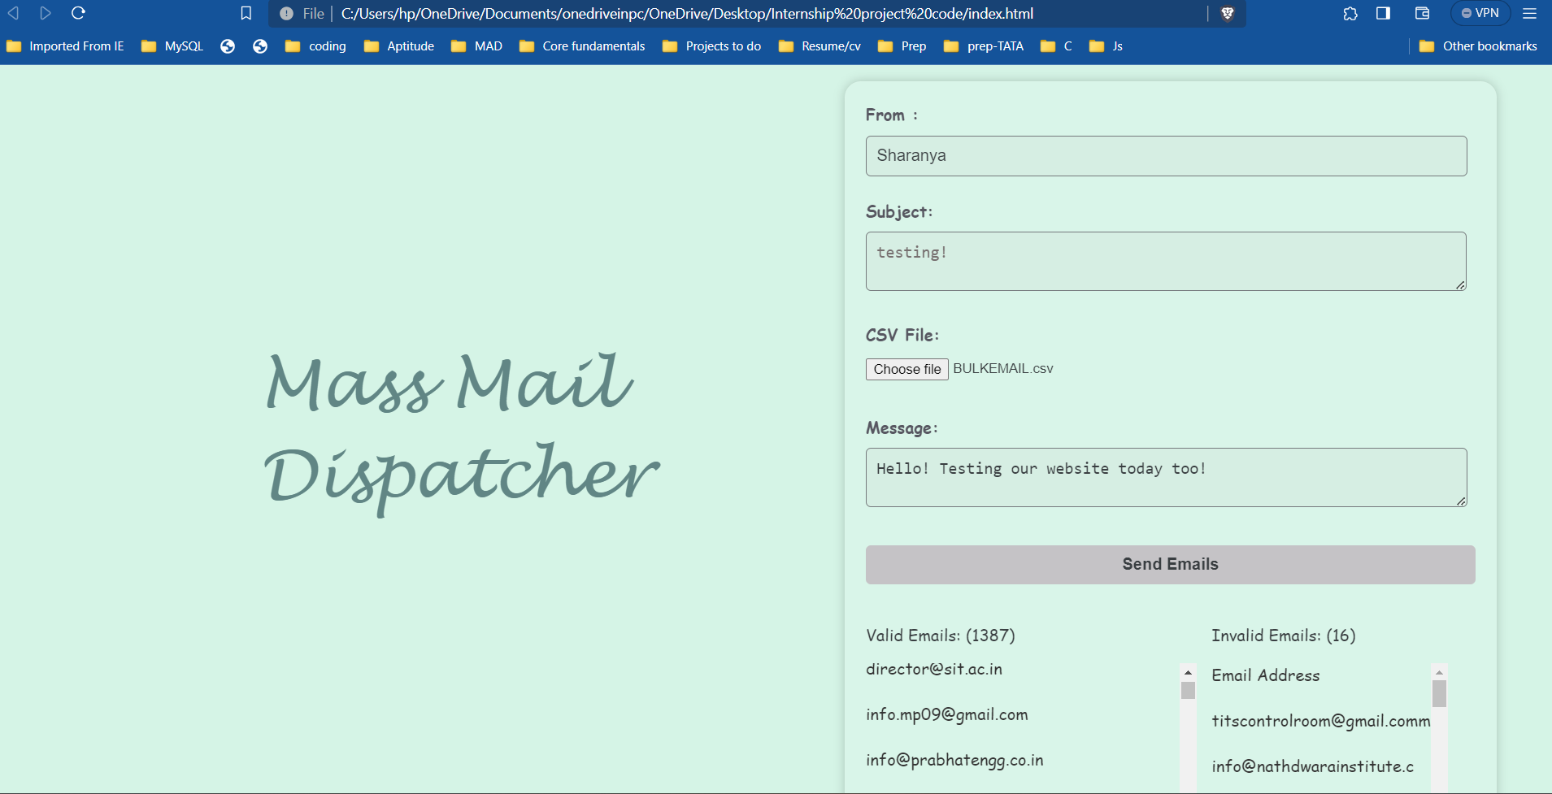
OUTPUT:
Output for bulk mail csv file:

Slide 8
THANK YOU!

